Slide 1

Statistical Data:
Variables, Data and Scales of Measurement
By
Saujanna Jafreen
Lecturer
Department of Natural Sciences
Daffodil International University(DIU)
21 May, 2014

Slide 2
Introducing Biostatistics
Objectives
A the end of the session the students should be able to:
Define Data , variable and their types and characteristics;
State the scales of measurement; illustrate each scale with appropriate example.

Slide 3
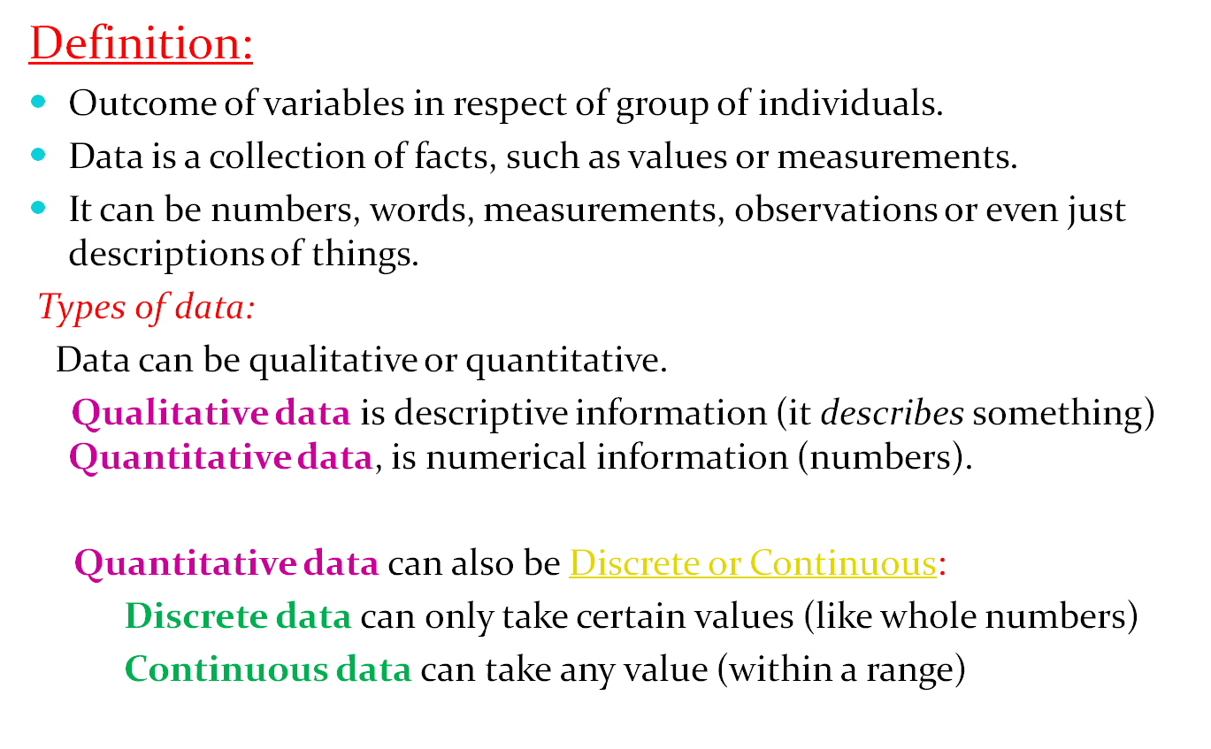
Data

Slide 4
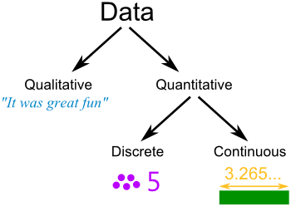

Slide 5
Example: What do we know about the Dog?
Qualitative: He is brown and black He has long hair He has lots of energy |  | Quantitative: Discrete: He has 4 legs He has 2 brothers Continuous: He weighs 25.5 kg He is 565 mm tall

Slide 6
Sources of Data
Data can be collected in many ways.
The simplest way is direct observation.
Example: you want to find how many cars pass by a certain point on a road in a 10-minute interval.
So: stand at that point on the road, and count the cars that pass by in that interval.
Sources of data may broadly be categorized as Primary sources(primary data) and secondary sources(secondary data).
Primary data come mainly from direct field operations, on the other hand , secondary data are usually procured from already published or unpublished documents.
Another sources are census or sample surveys.
A Census is when you collect data for every member of the group (the whole "population").
A Sample is when you collect data just for selected members of the group.

Slide 7
Variable:
Variable = Vary + able
Any characteristic or measurement that is able to vary.
Qualitative Variable:
Outcome stated in narrative form e.g.
Sex: Male/Female
Quantitative Variable:
Outcome stated in number or quantity e.g.
Height, Weight etc.
Nature of variable:
Discrete ( e.g. Parity- 0, 1,2….. )
Continuous: Height (e.g. 65.234509 inches)

Slide 8
Variable Types & Nature
Variable
Type:
Qualitative
Quantitative
Discrete
(whole number)
Discrete
(whole number)
Continuous (any value)
Nature:

Slide 9
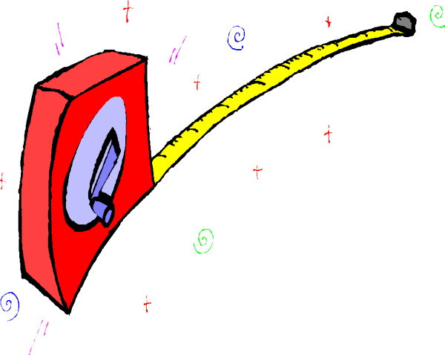
Scales of measurement
Measurement scales are used to categorize and / or quantify variables. We use four scales of measurement for statistical analysis with four properties of measurement , identify, magnitude, equal intervals and minimum value of zero. The four scales are :
1. Nominal
2. Ordinal
3. Interval
4. Ratio

Slide 10
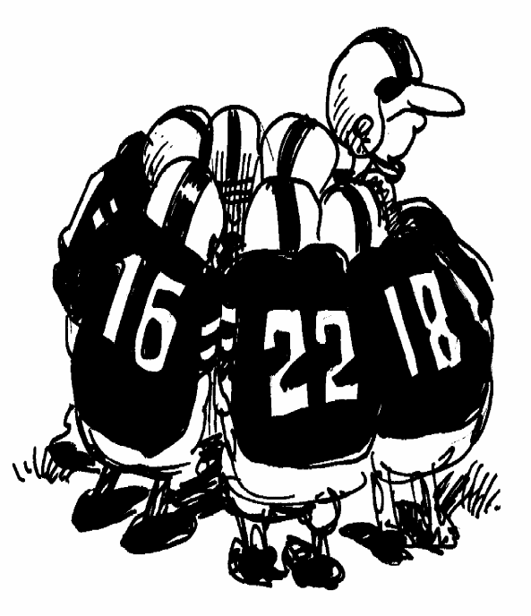
Scales of measurement
(1) Nominal:
Only satisfy the identity property of measurement
Use for qualitative variable
No numerical value
Example: 1. Gender
2. Name of school
3. Name of book

Slide 11
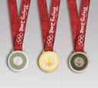
Scales of measurement
(2) 0rdinal:
1. It has both property of identity and magnitude, that’s name and order
2. Use for qualitative variable
3. Examples: 1. Team/individual standing
2. Socioeconomic status
3. Level of education
4. Any type of rating or ranking

Slide 12
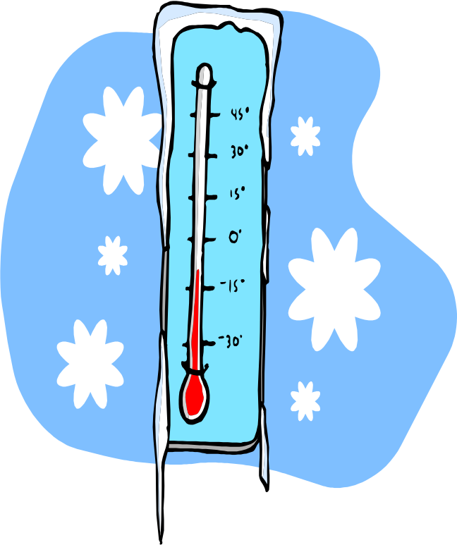
Scales of measurement
(3) Interval
1. It satisfies the properties that’s are identify, magnitude ,equal intervals
2. Use for quantitative variable
3. Zero does not mean Zero (0)
4. Examples: 1. Temperature scales
2. IQ scores
3. Psychological measure
4. Dress size

Slide 13

Scales of measurement
  (4) Ratio:
  It satisfies all four properties of measurement
  Use for quantitative variable
  An absolute zero indicates a complete absence of the attribute being. That is Zero
  means Zero (0)
  Examples: 1. Income
  2. Length
  3. Height
  4. Weight

Slide 14
Variable Types and scales of measurement
Variable
Type:
Qualitative
Quantitative
Normal
[name only
no order]
eg.Sex (M/F)
Ordinal
[name + order]
Pain severity(mild, mod., severe)
Interval
0 not implies absence
Temperature
Ratio
0 imply absence
Height
Scale:
Scales of Measurements

Slide 15
Thank you

